Slide 1

Week2:
Basis of Deep Learning (1)
Machine Learning Using Tensorflow
Shu-Ting Pi, PhD
UC Davis

Slide 2
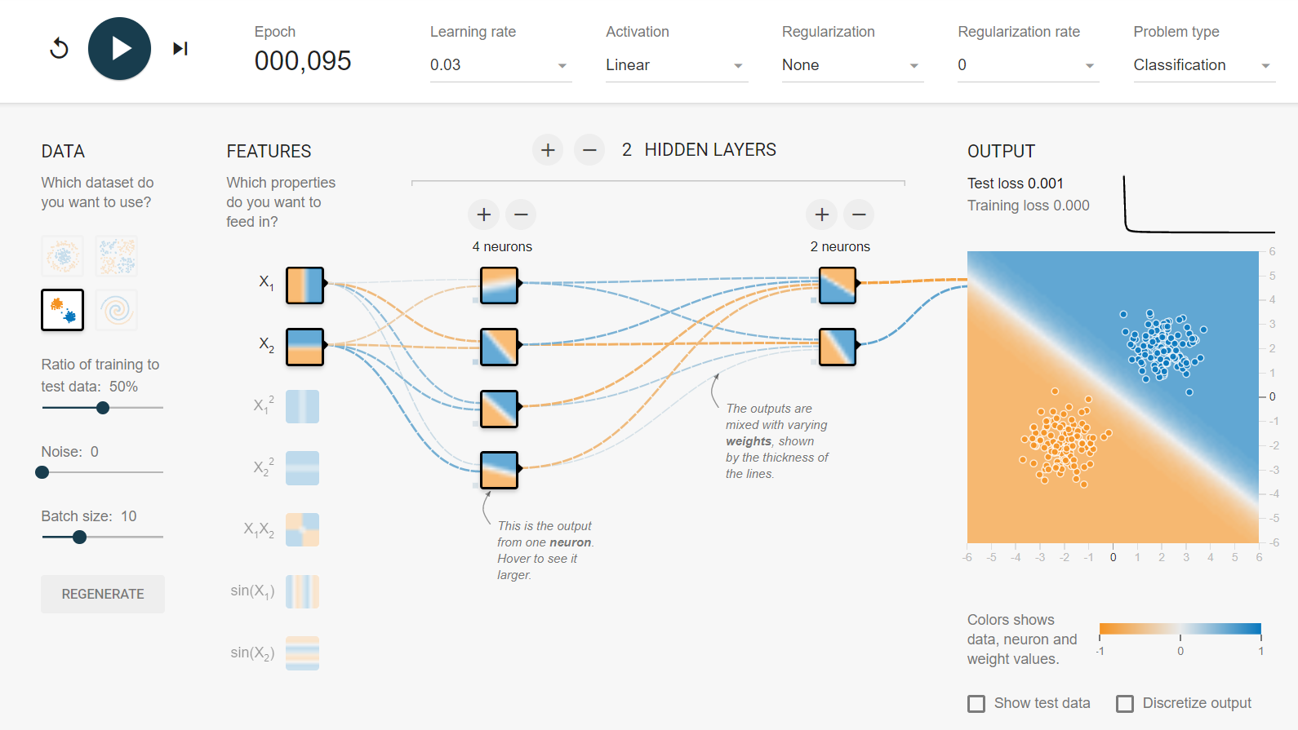
Tensorflow Playground
TF playground is particular useful to give you some hints to fine tune the parameters of your network.

Slide 3

linear neural network
h1
x1
x2
x3
- Only works for linear separable data
- multilayer structure is meaningless !
Machine Learning using Tensorflow
Shu-Ting Pi

Slide 4

Nonlinear neural network
bias
1
bias
1
Biases: sensitivity of the node
Activation function: nonlinearlize the inputs

Slide 5
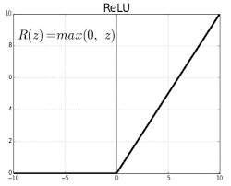
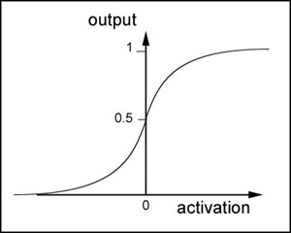
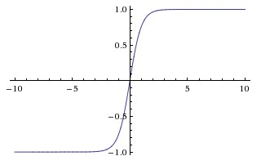
Activation functions
How to nonlinearize? Think about human neural network!
Relu
Sigmoid
tanh
Neural nodes become “active” after the input if higher than a threshold
and become “numb” if input is too high (sigmoid & tanh).

Slide 6
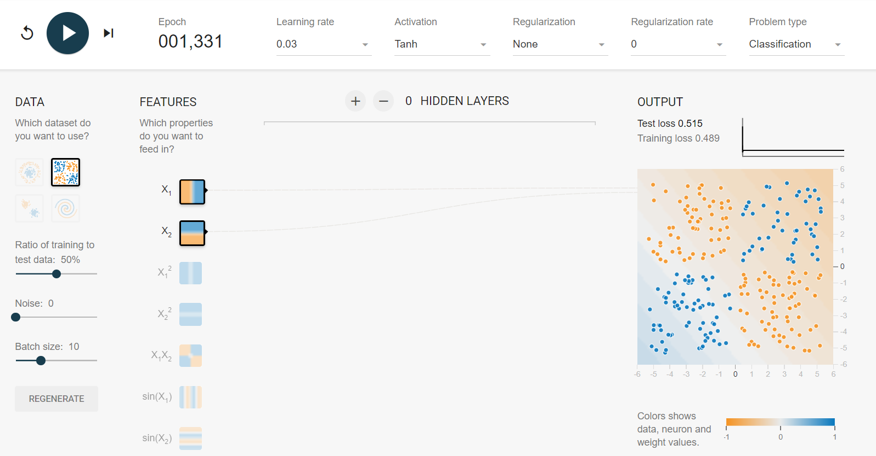
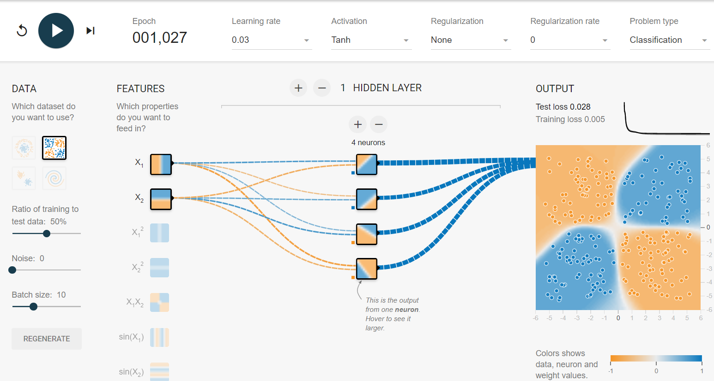
Why multilayer?
It is proven that single layer NN can not solve “XOR” problem!
Don't dig into the math, let's prove it using tensorflow playground!

Slide 7
Cross Entropy

Slide 8
Softmax

Slide 9
Loss functions

Slide 10
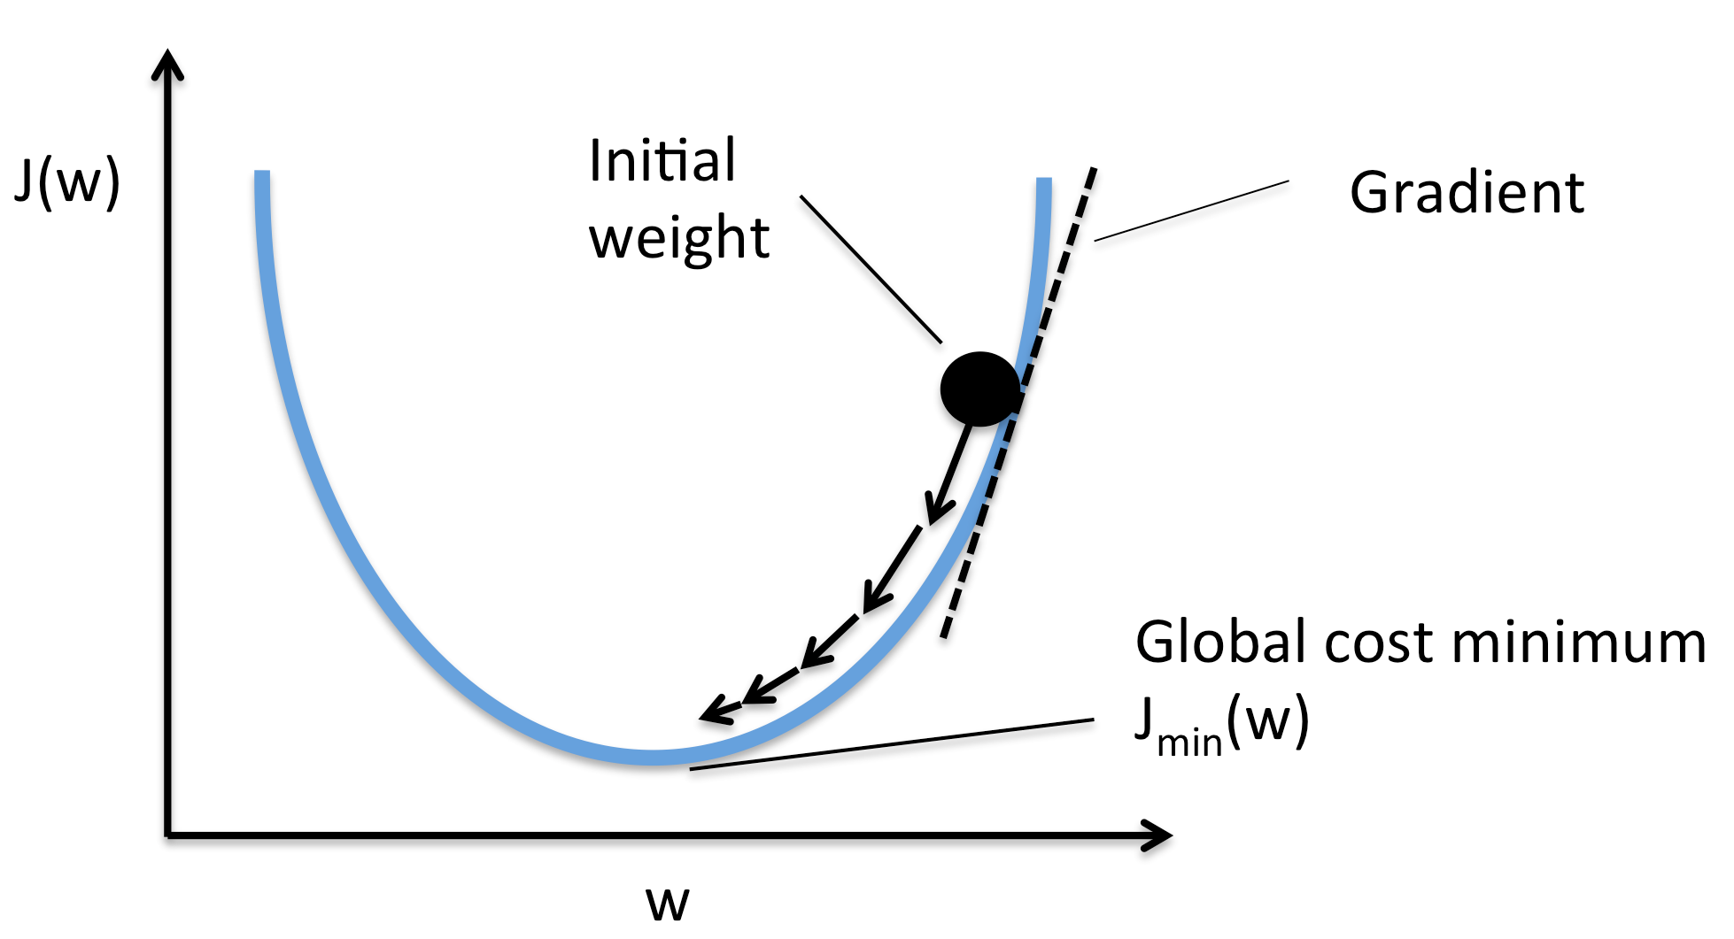
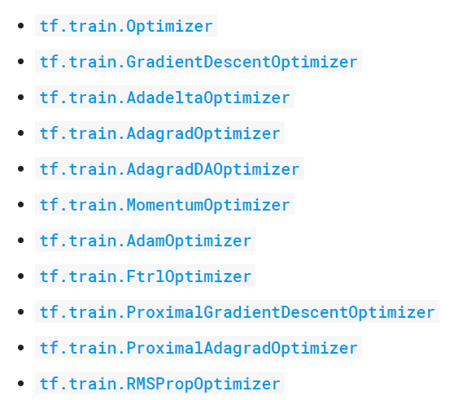
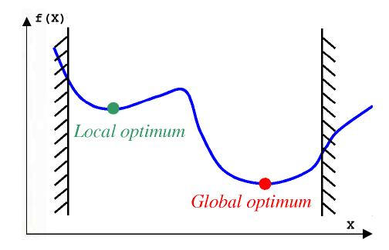
Optimizer
Alpha go!

Slide 11
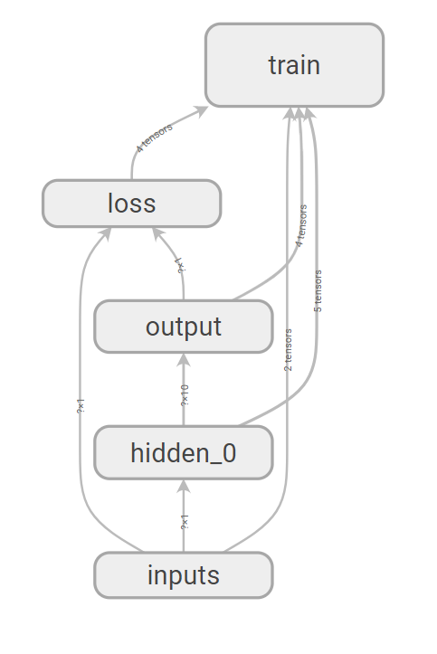
How does tensorflow work?
Construct computation graph
  - tf.Variable
  - tf.constant
  - tf.placeholder
  - tf.layers.dense
  - tf.train.GradientDescentOptimizer
Make tensors flow
  - tf.global_variables_initializer()
  - tf.Session()
  - tf.Session.run( , feed_dict={} )

Slide 12
Let's do it !
Steps
  - generate raw data, say y=x^p+x0
  - Define

